Slide 1
Report On Demographic Data
In New York City Public Schools
2015-2016 Demographic Data - Grades K-8 School

Slide 2
The Goal of the Project
The Goal of this project to create a report of New York City Public Schools demographic data provides information for:
Baseline data for school-based planning and program monitoring
To collect data from data.gov
Create a summary statistics of dataset
Summarizes the number and percentage of students enrolled in the various regions by grade level.
To summarize the percentage of Females and Males to enrolled in different regions.
To identify the test takers from various countries and different categories.

Slide 3
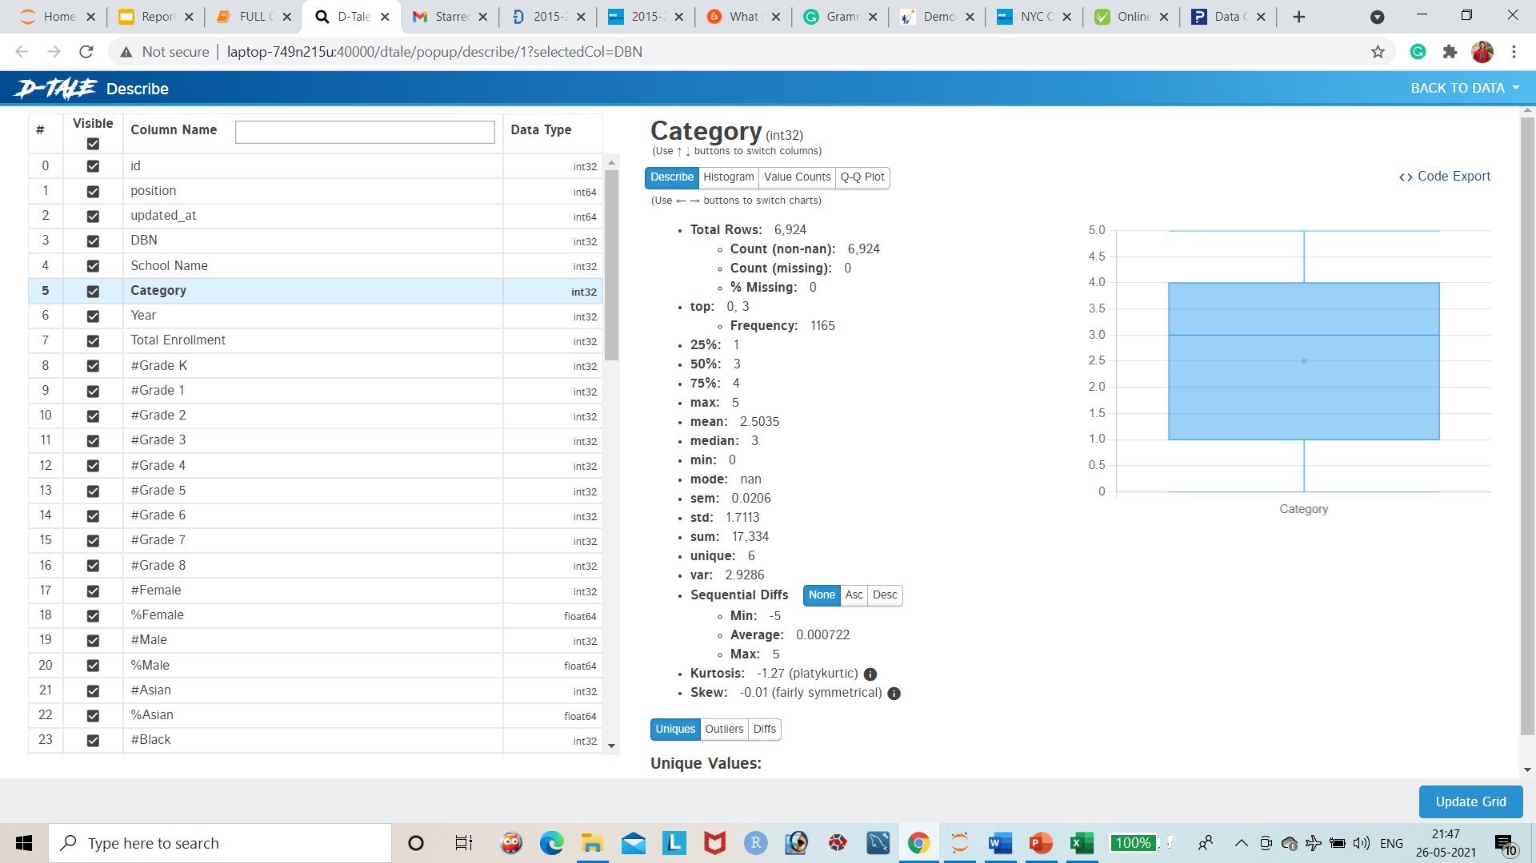
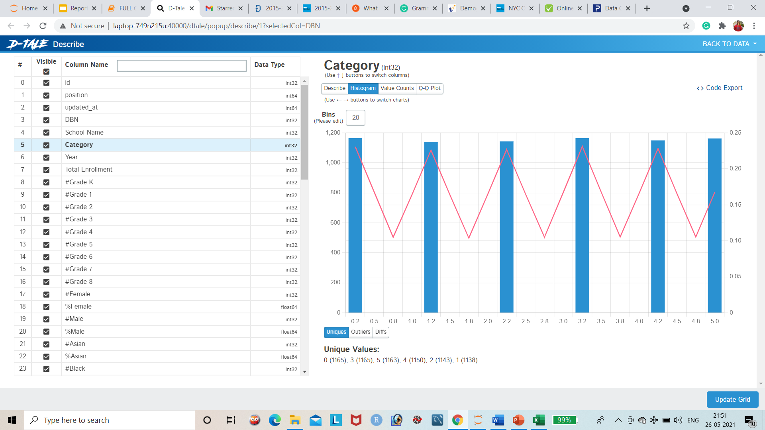
Category of Students
In this bar graph represents there are 6 categories of students.
Unique Values: 0 (1165),
3 (1165),
5 (1163),
4 (1150),
2 (1143),
1 (1138)

Slide 4
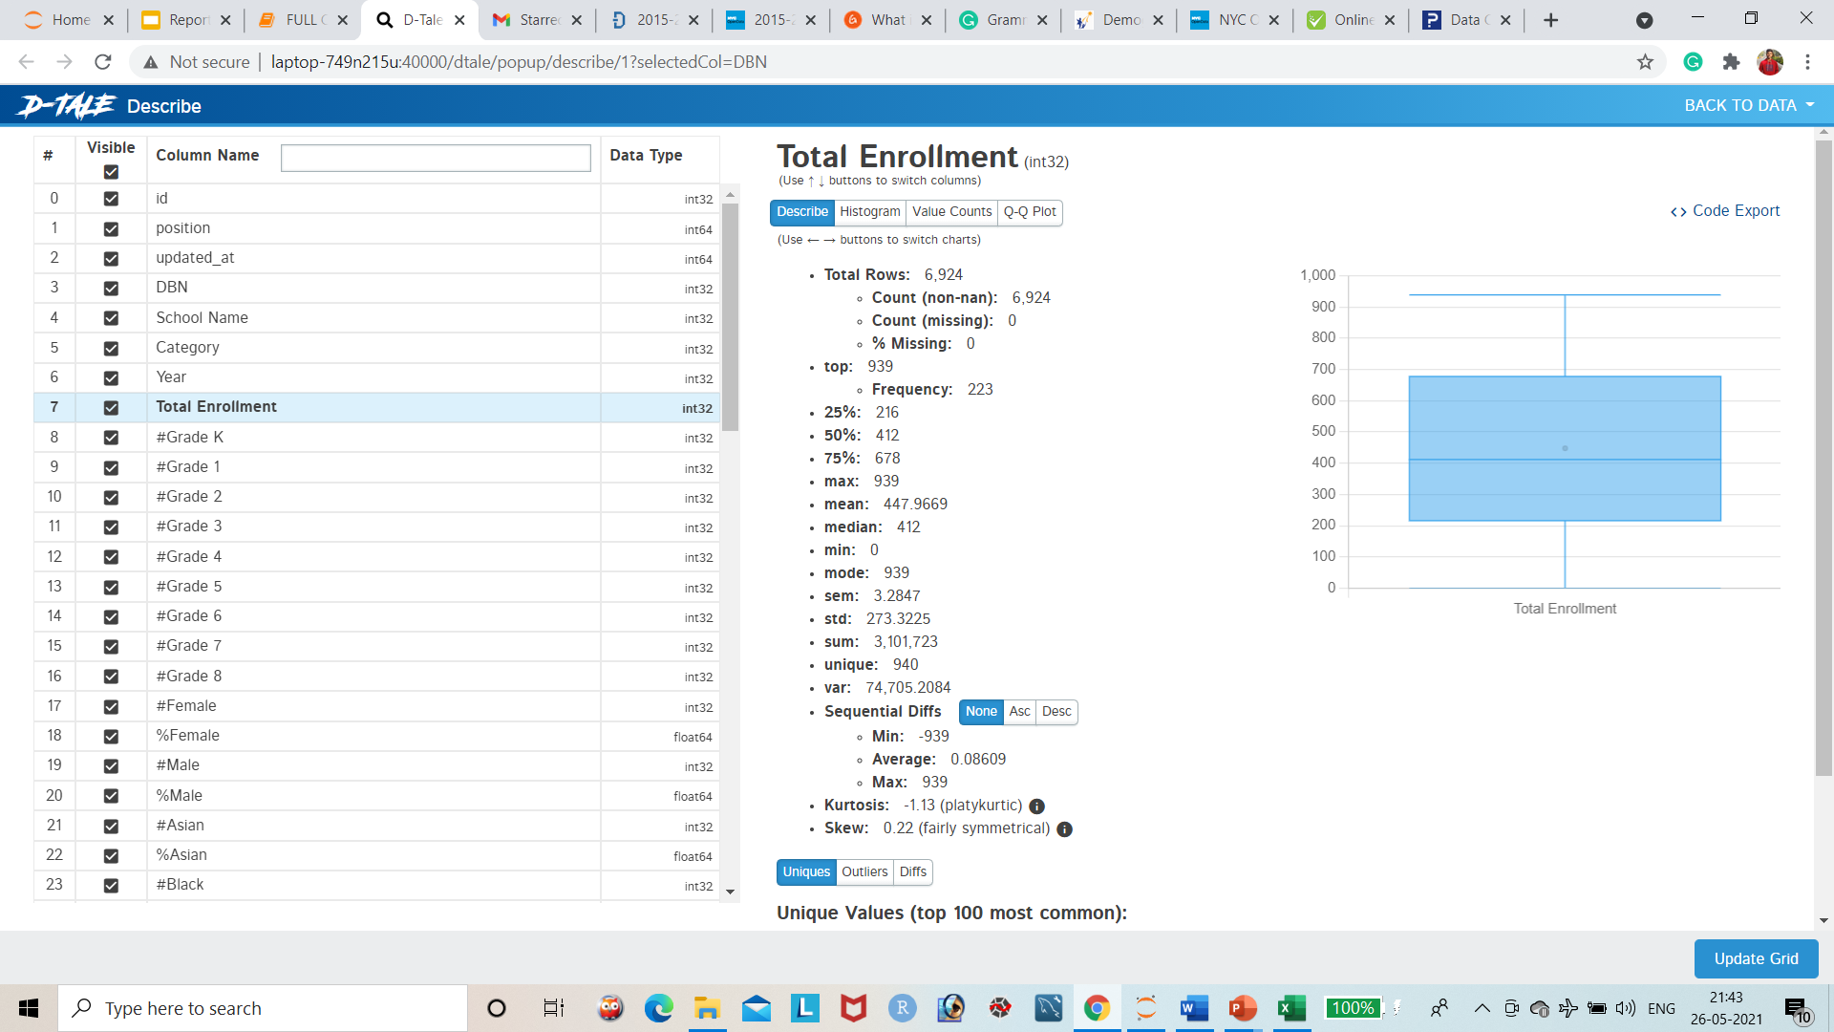
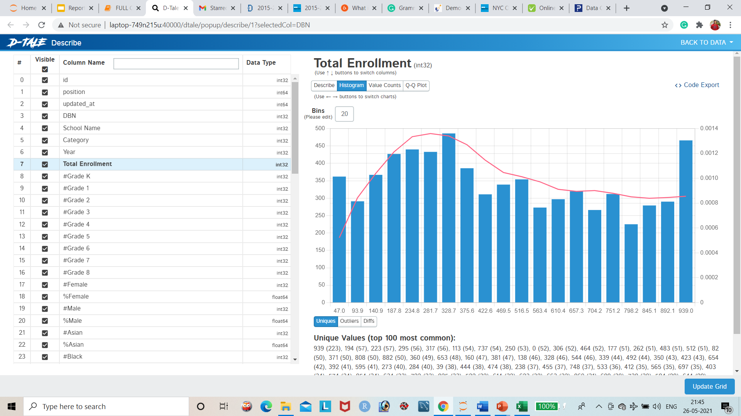
Total Enrollment of the Students
This Chart represents the total enrolment of the student in this column we have 940 unique labels.
The highest frequency is 486 in this column.

Slide 5
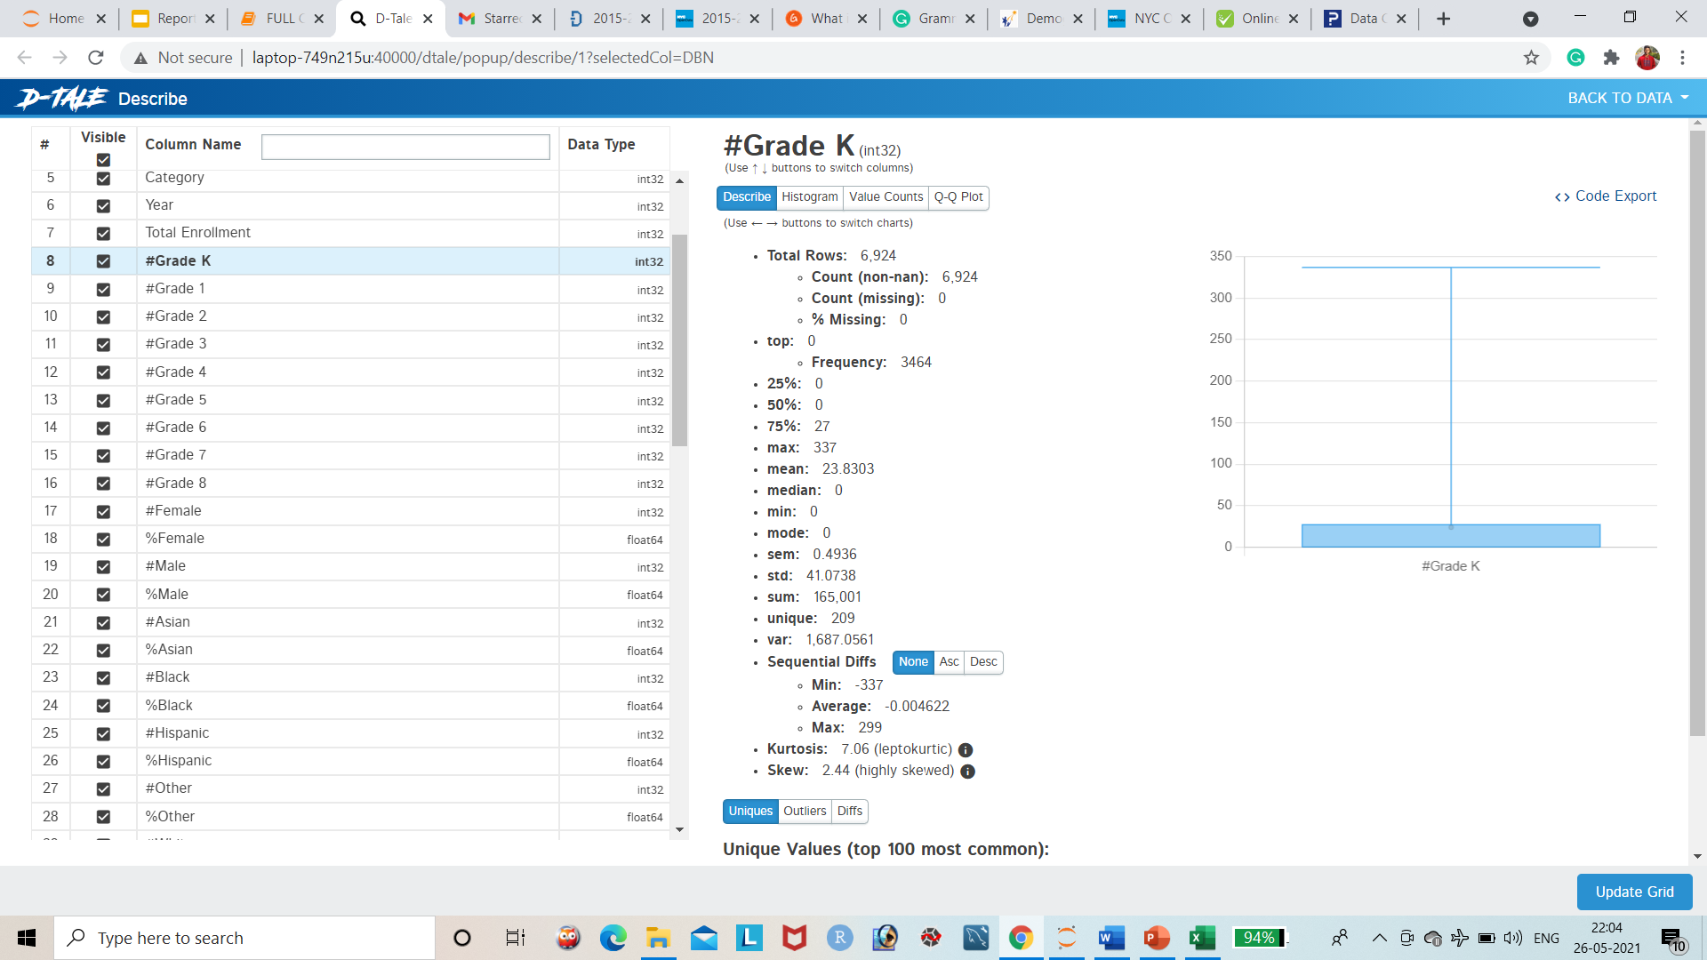
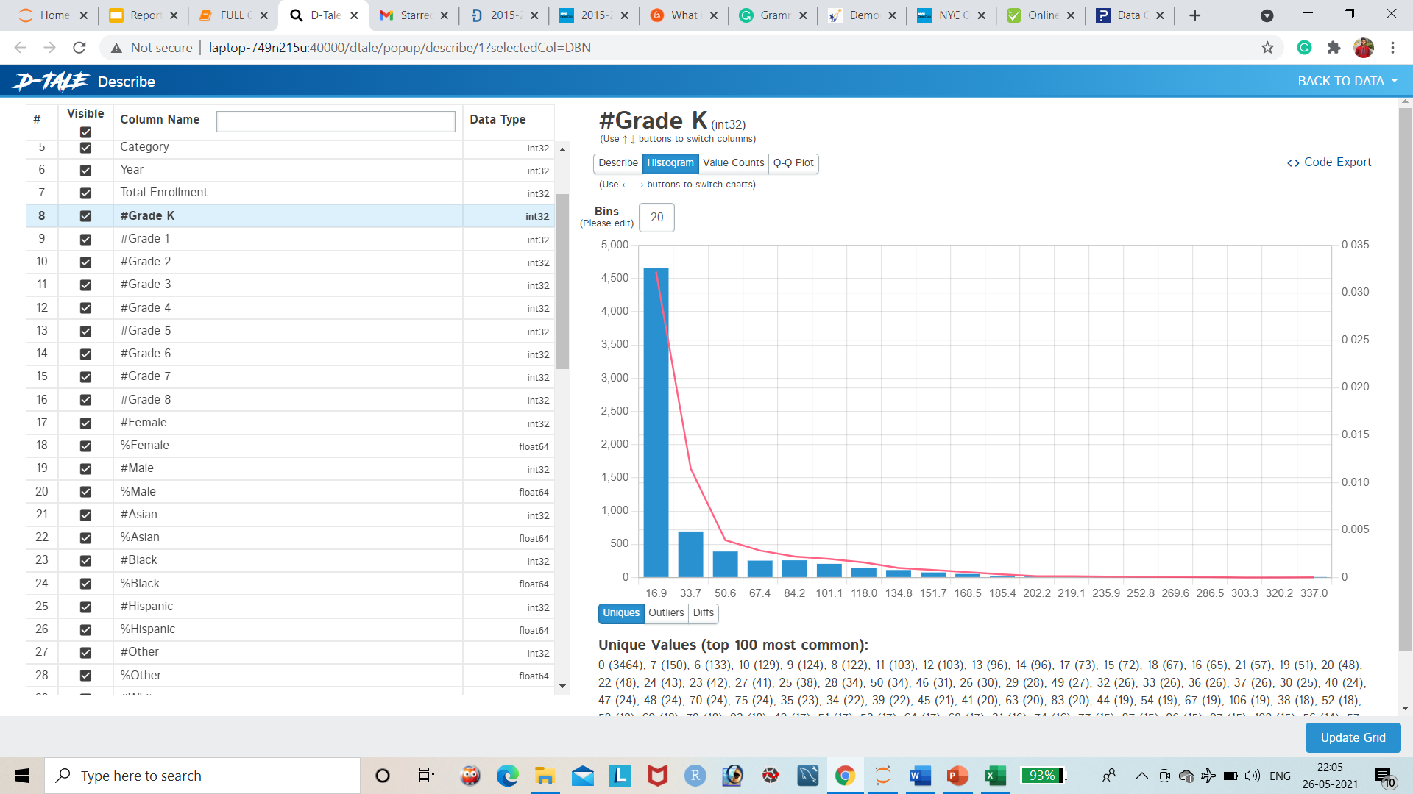
Level of Grade K
In this chart represent the feature have most of the value is zero,
There are 3464 is zero and 100’s of outliers detected.

Slide 6
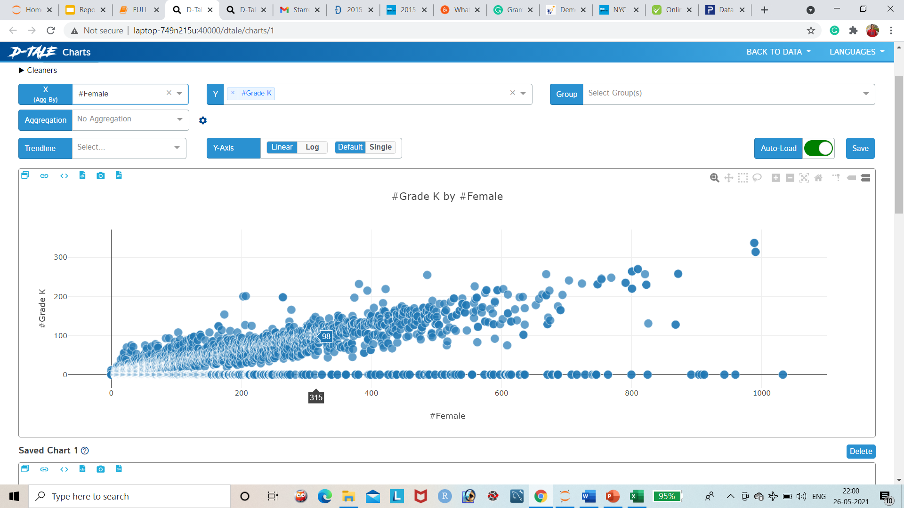
Level of Grade-k by Female
This Scatter Plot represents the level of grade-k by female students

Slide 7

Level of Grade-k by Male
This Scatter Plot represents the level of grade-k by male students

Slide 8
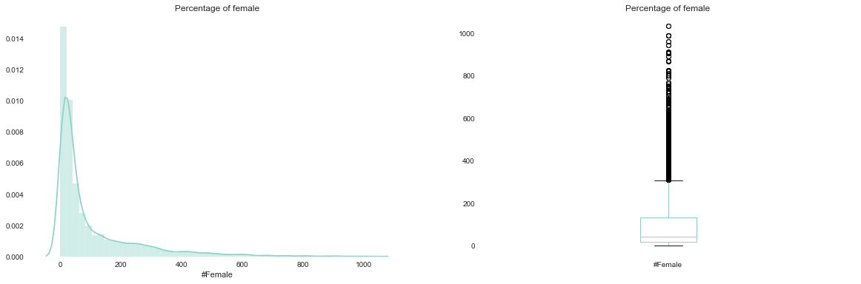
Percentage of Females
This graph presence most of the females showing zero..
The boxplot represents, so many Outliers in this column.

Slide 9
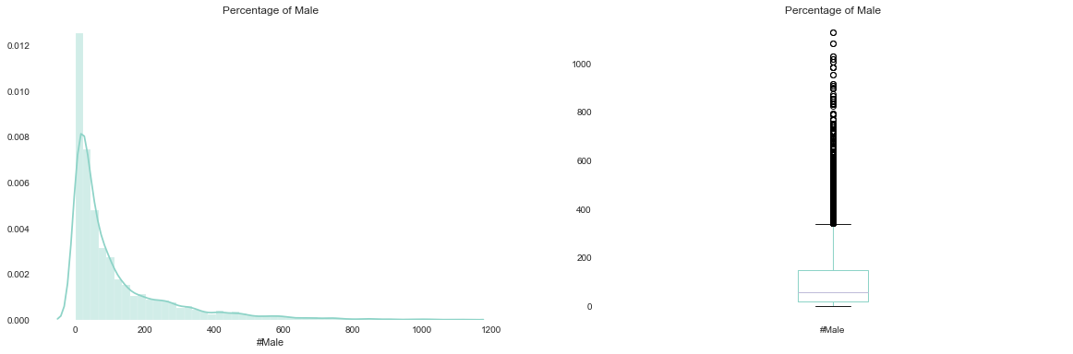
Percentage of Males
This graph presence most of the Males showing zero..
The boxplot represents, so many Outliers in this column.

Slide 10
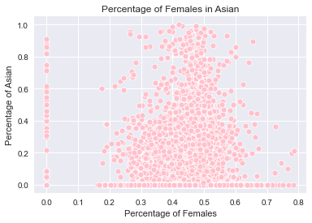
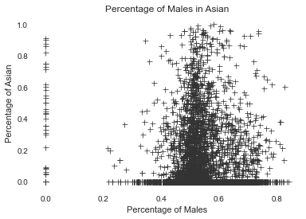
Total Percentage of Females and Males in Asia
In this graph represents the percentages of Males and Females in the data. When compared Between Females And Males, The Females Have more percentage than Males in Asia

Slide 11
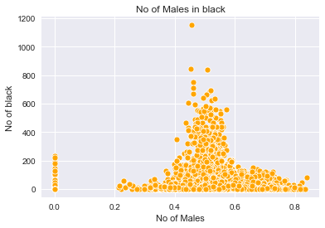
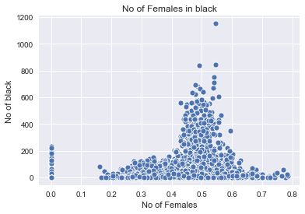
Number of Females and Males in Black
In this chart both Females and Males are equally in Black .

Slide 12
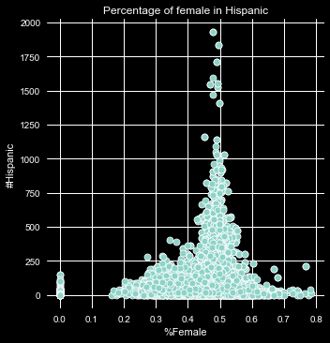
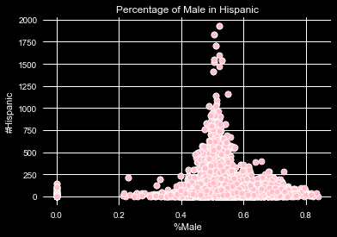
Percentage of Females and Males in Hispanic
This graph represents both Females and Males are equally in Hispanic Column.

Slide 13
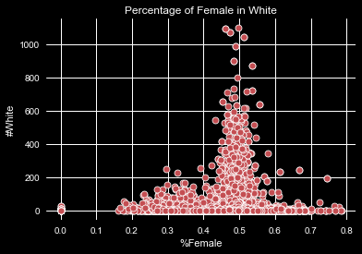
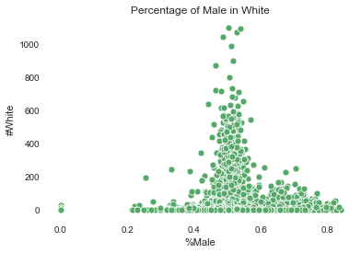
Percentage of Females and Males in White
This scatter plot represents both Males and Females are around 50% of peoples are White.

Slide 14
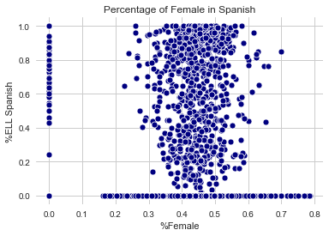
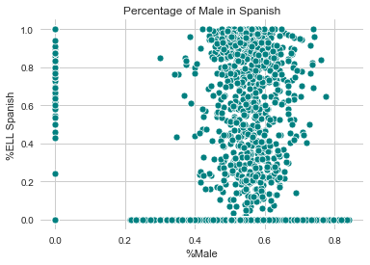
Percentage of Females and Males in Spanish
This graph presence when compared the both Female and Male column males have more percent in Spanish

Slide 15
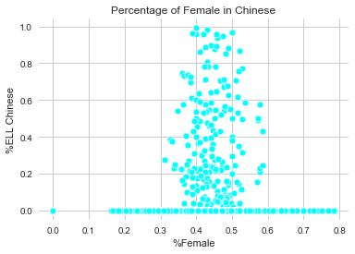
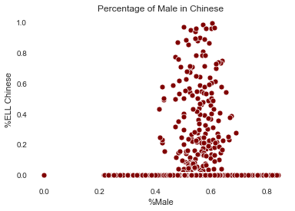
Percentage of Females and Males in Chinese
In this chart also Males have more percentage in Chinese when compared with females.

Slide 16
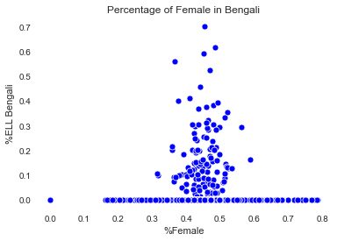
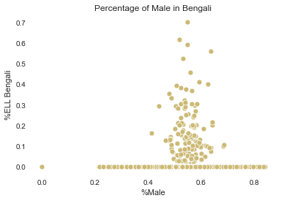
Percentage of Females and Males in Bengali
This scatter plot represents both Males and Females are around 50-60% of peoples are Bengali.

Slide 17
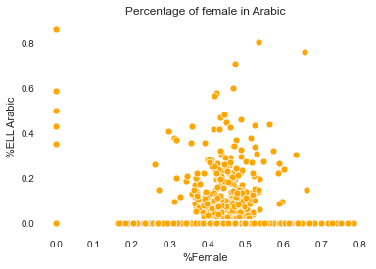
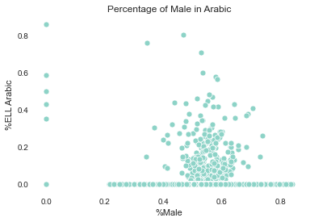
Percentage of Females and Males in Arabic
In this graph represents the female have 40-50% and males have 50 -60% in Arabic region.

Slide 18
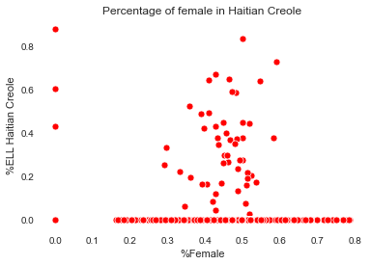
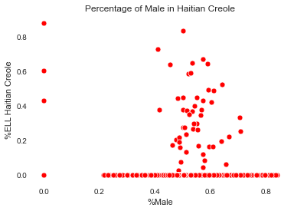
Percentage of Females and Males in Haitian Creole
This graph produces less numbers of students in both females and males students in Haitian Creole

Slide 19
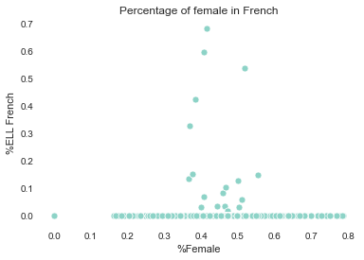
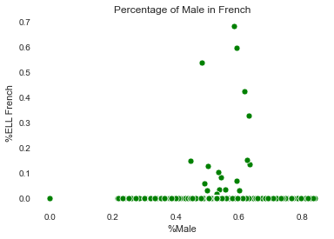
Percentage of Females and Males in French
In this chart when compared to the other regions French students are less percentage.

Slide 20
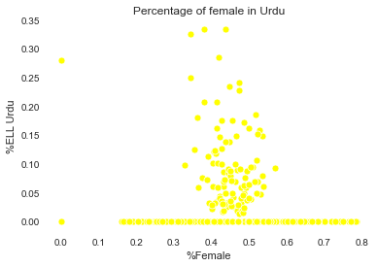
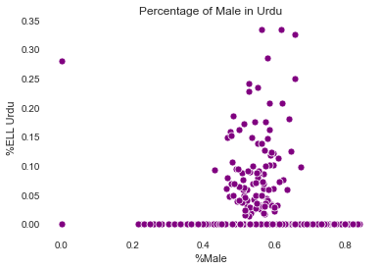
Percentage of Females and Males in Urdu
The Female students have 40 -50% of students and the male students have 50-60% of Urdu

Slide 21
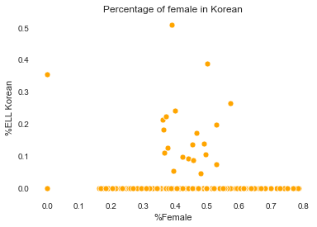
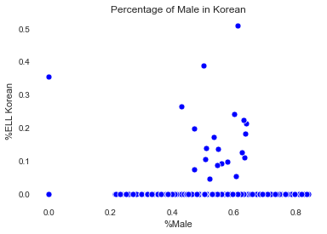
Percentage of Females and Males in Korean
In Korean students both females and males are equal percentage.

Slide 22
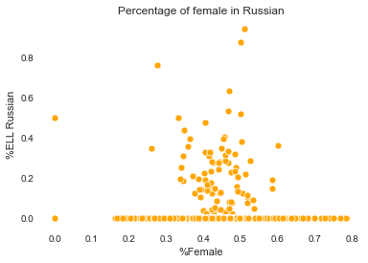
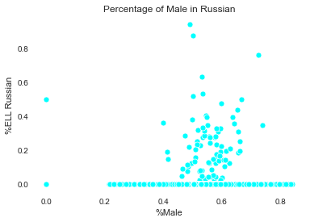
Percentage of Females and Males in Russian
In this graph produces Russian region female and males have 40-60% of students.

Slide 23
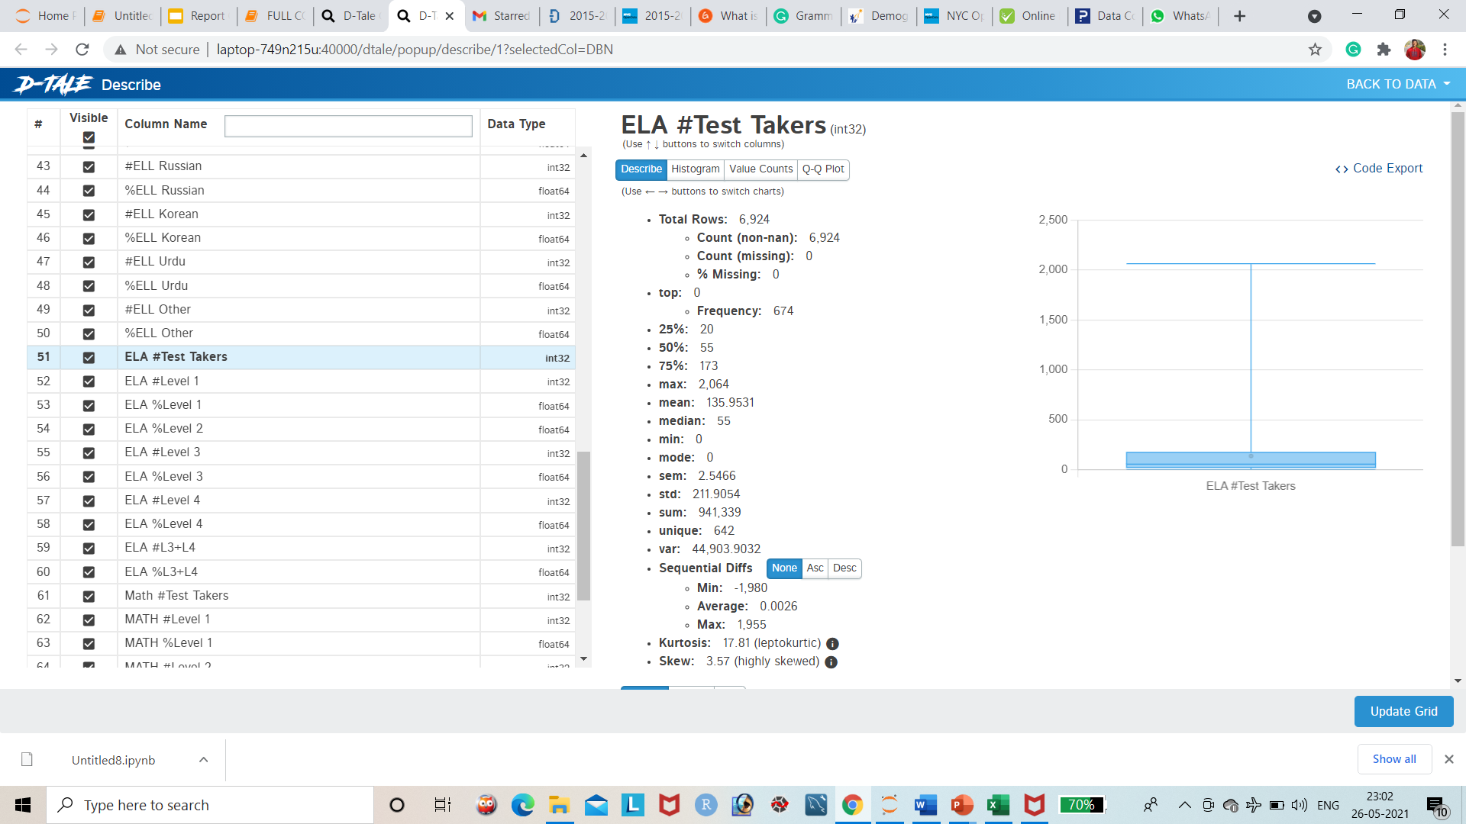
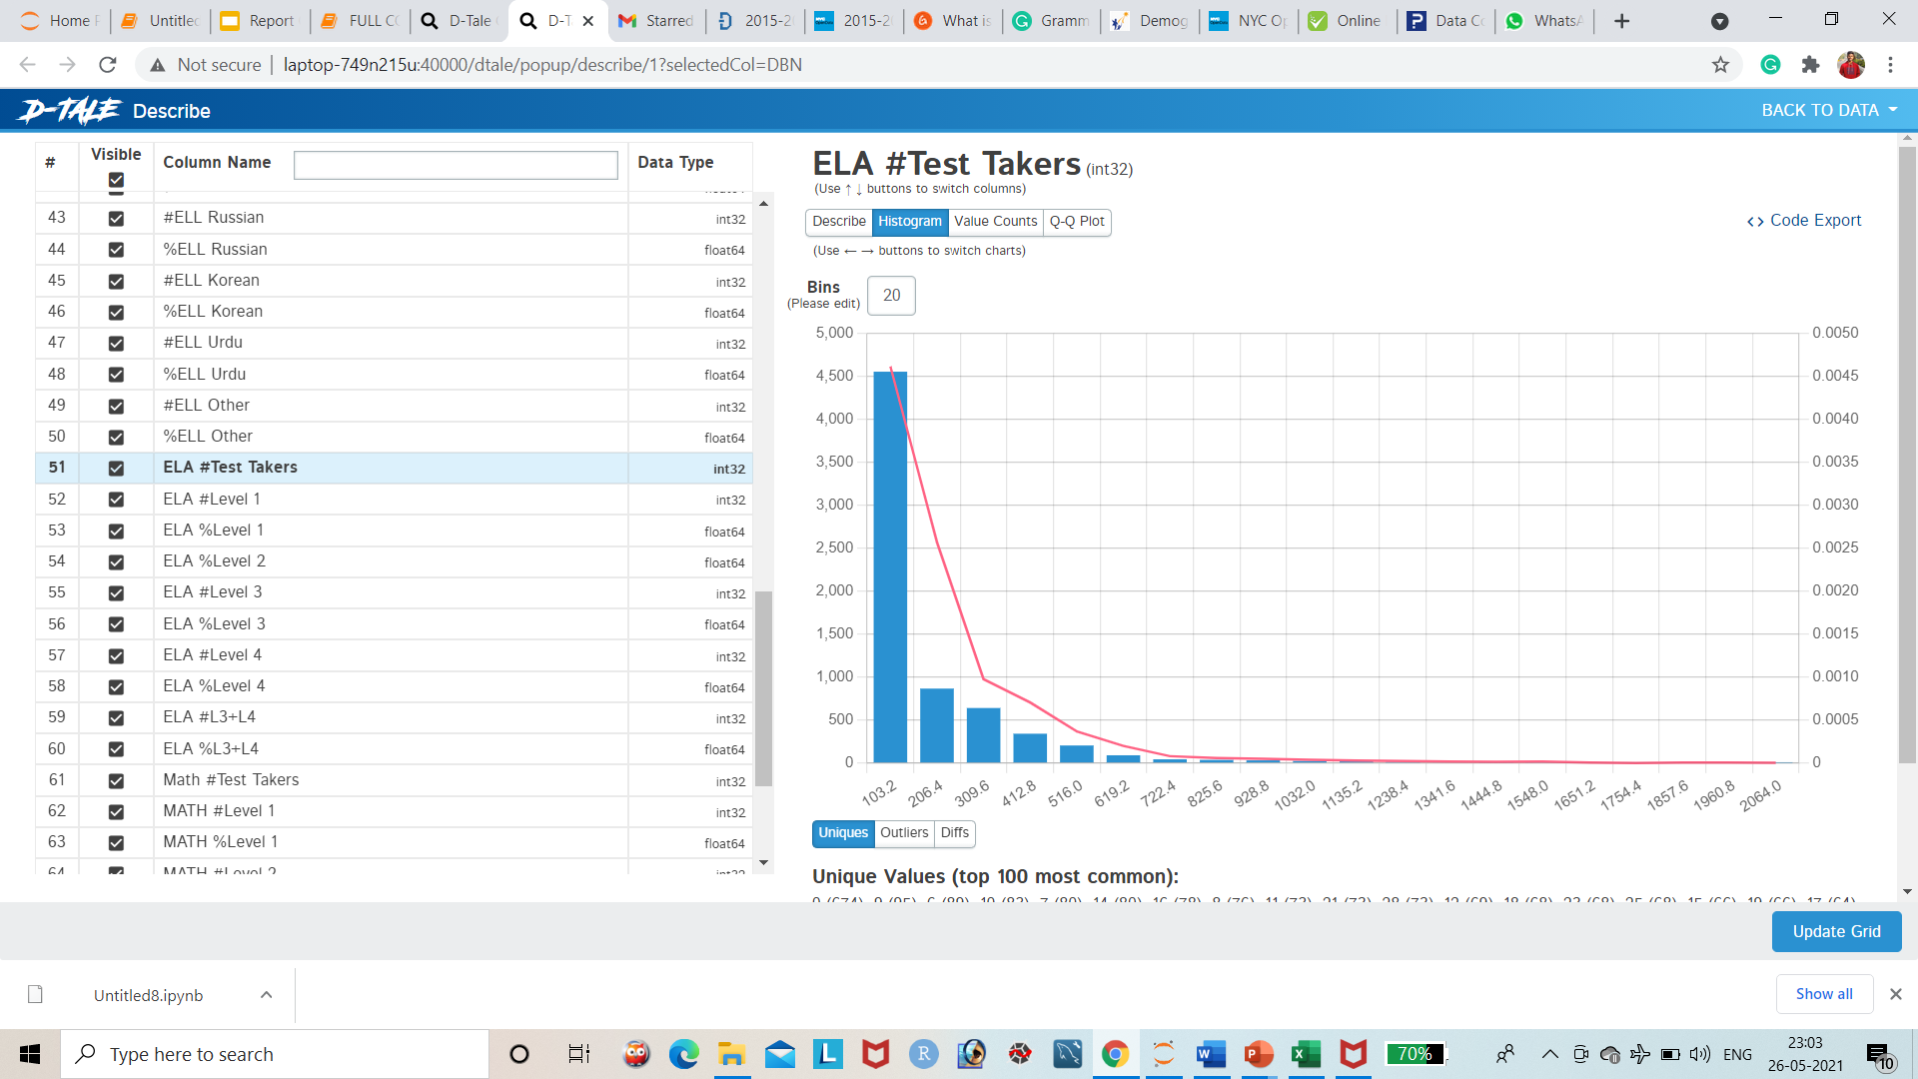
Percentage of ELA Test takers
This graph represents the ELA test takers students, The frequency is 674 in this column, there are 642 unique labels have in this column.

Slide 24
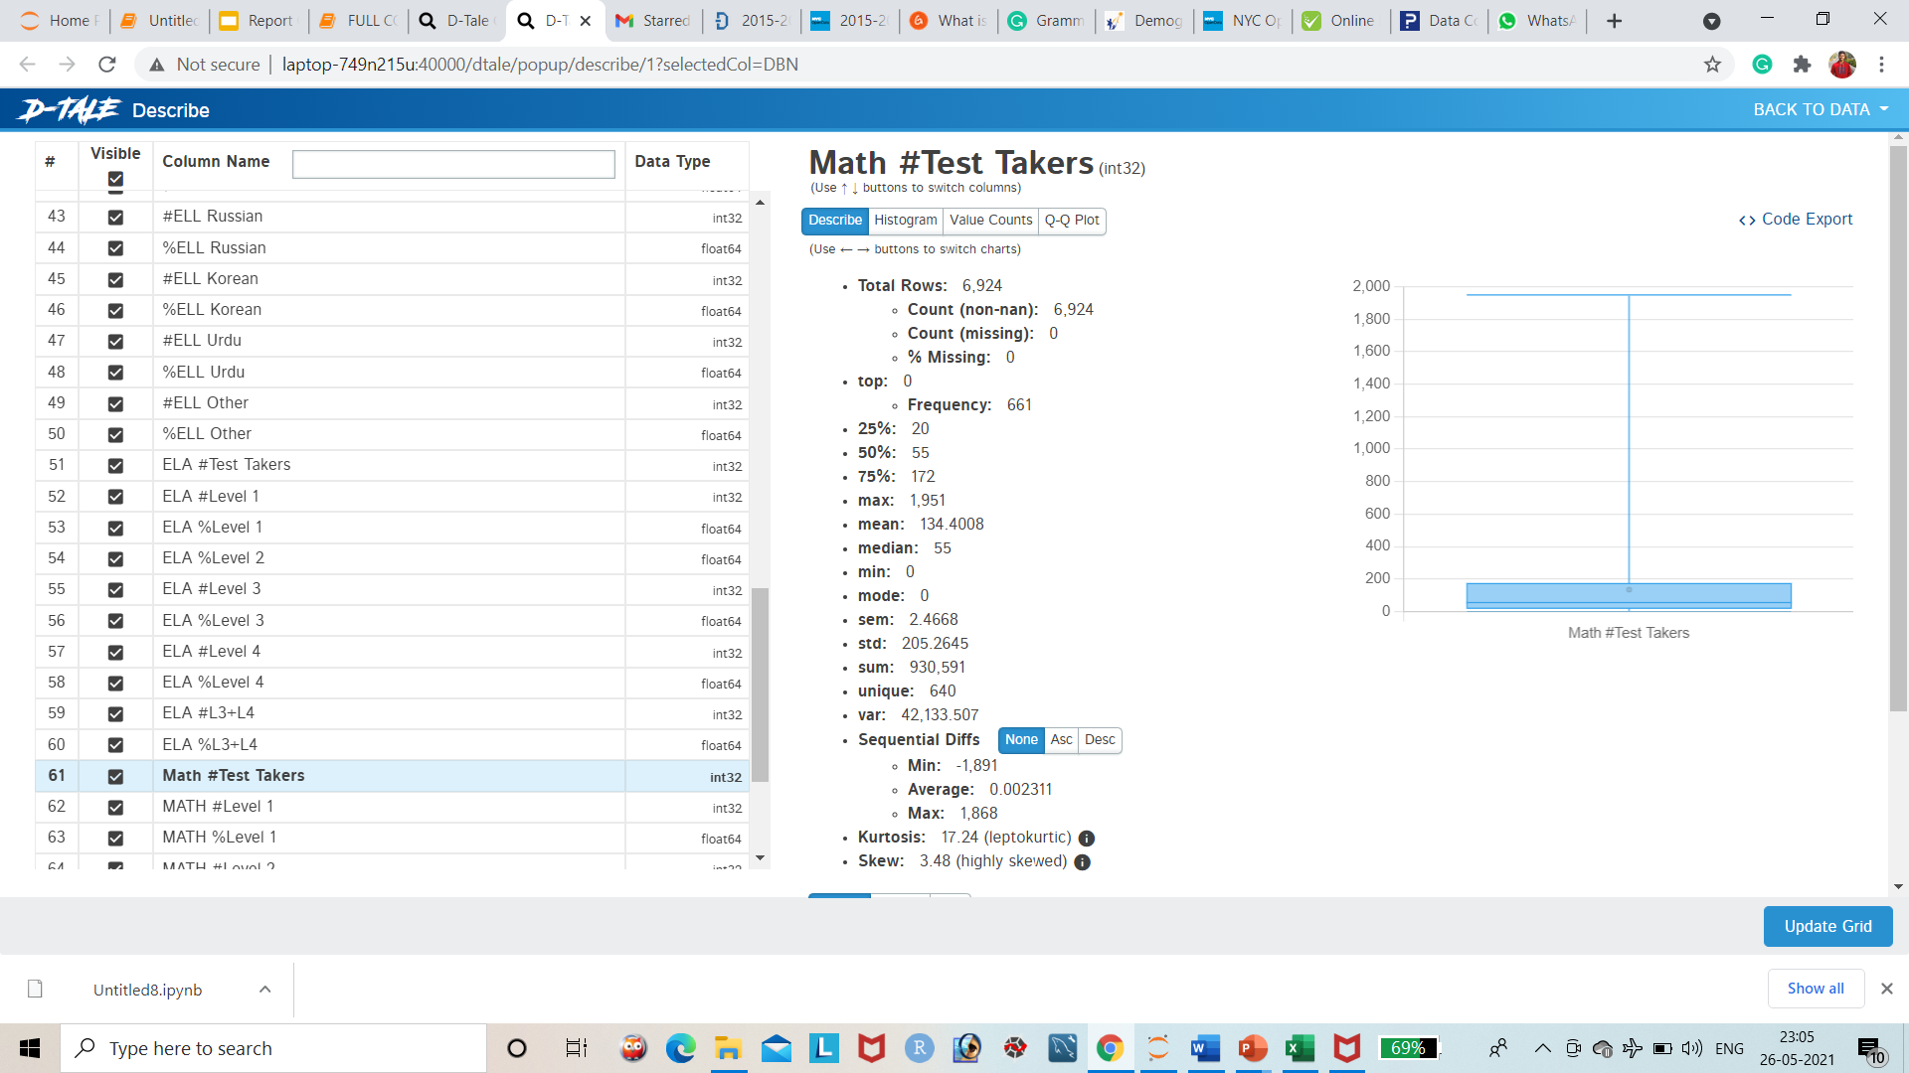
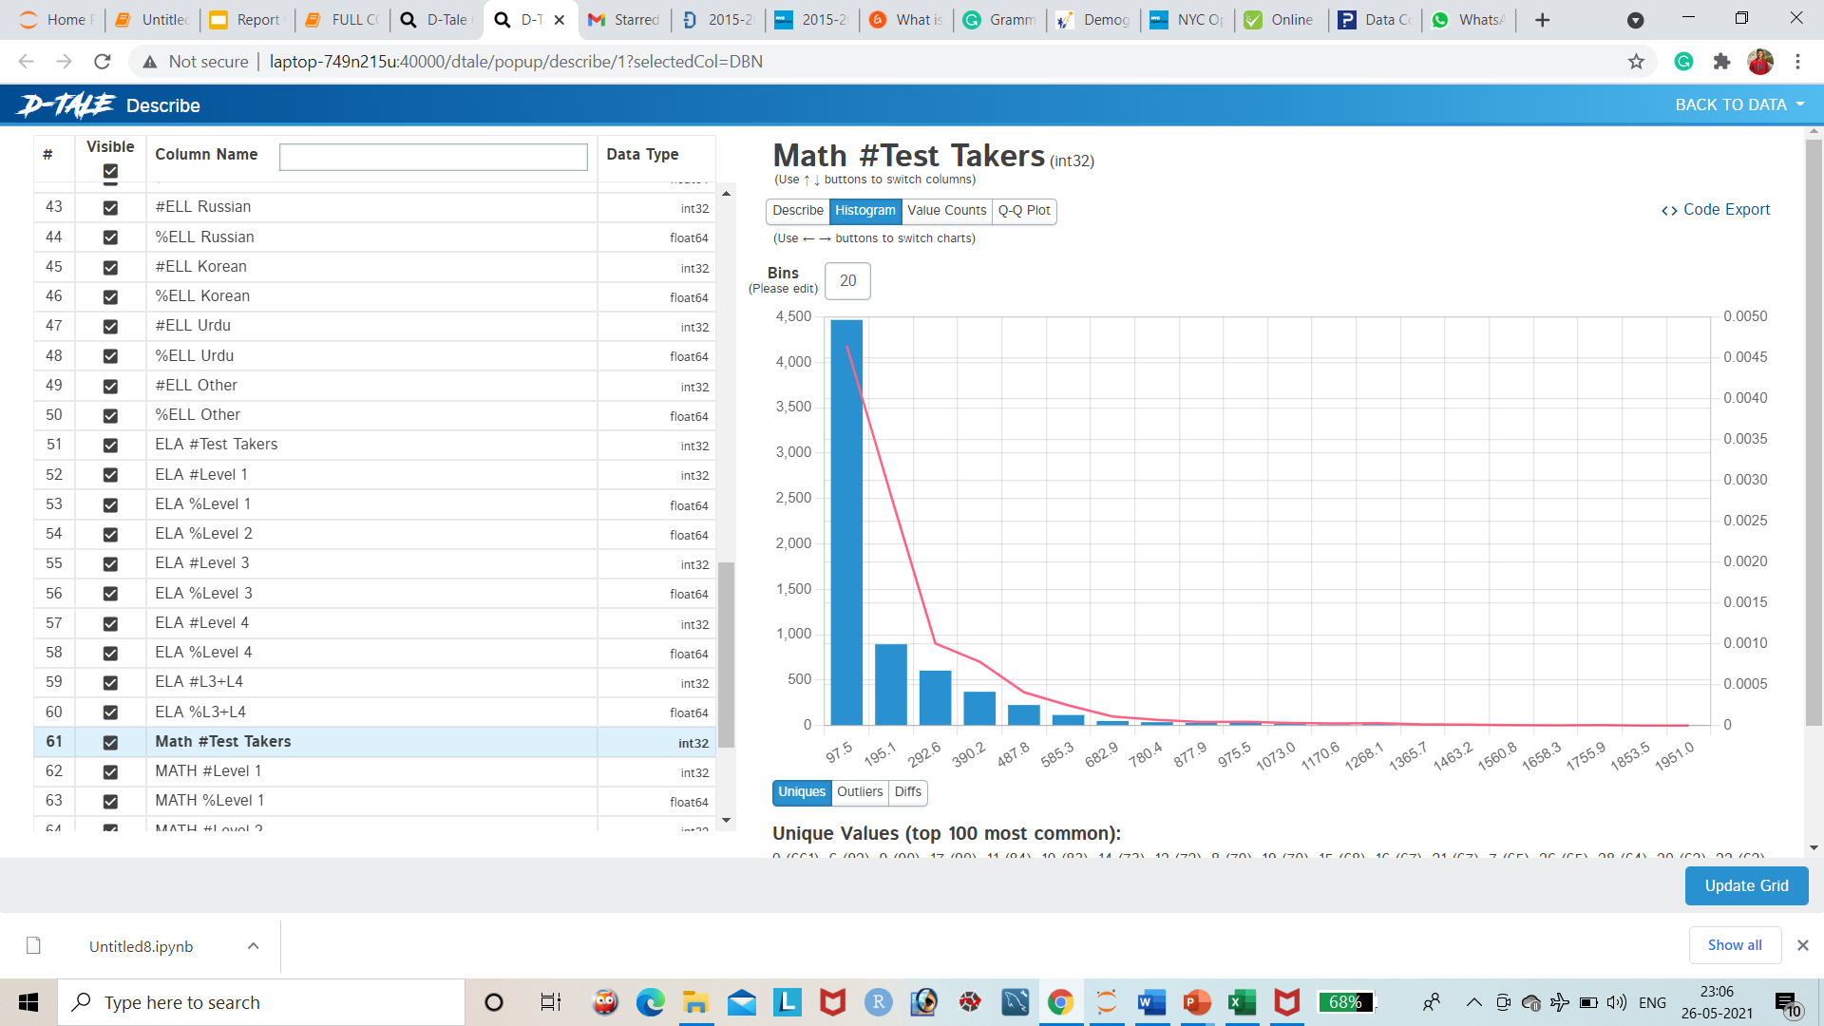
Percentage of Math Test takers
This graph represents the Math test takers students, The frequency is 661 in this column, there are 640 unique labels have in this column.

Slide 25
Thank you…

